Slide 1
Fill in the Word(s)
Warmer Activity
Write a few words or a long word on the board in a vertical format. This can be done on the whiteboard as a whole class or on mini-board in groups. The higher the level, the longer the word.
Notes:
Write a few words or a long word on the board in a vertical format:
This can be done on the whiteboard as a whole class or on the mini-board in groups.
The higher the level, the longer.

Slide 2
Up to Nine Letters

Slide 4
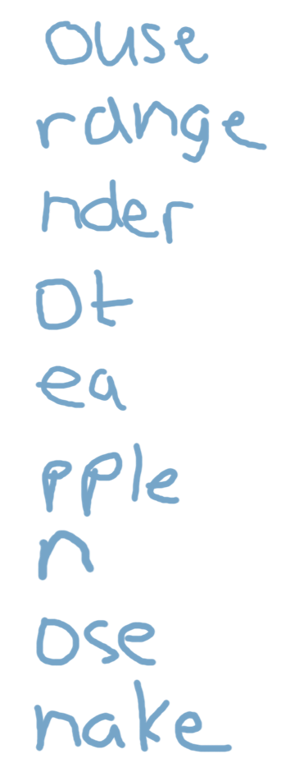
m
o
u
n
t
a
i
n
s

Slide 6
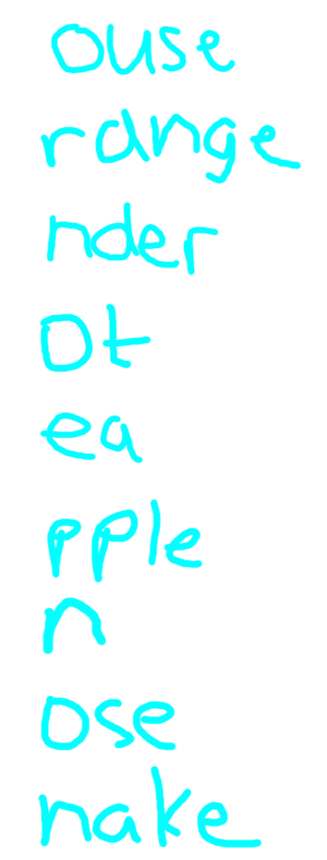
m
o
u
n
t
a
i
n
s

Slide 7
Up to Thirteen Letters

Slide 9
d
i
s
a
p
p
o
i
n
t
i
n
g

Slide 10
d
elicious
i
nvention
s
illy
a
nnoying
p
ainting
p
ink
o
ctopus
i
ntelligent
n
ectarine
t
elephone
i
njection
n
ineteen
g
ills

Slide 12
d
elicious
i
nvention
s
illy
a
nnoying
p
ainting
p
ink
o
ctopus
i
ntelligent
n
ectarine
t
elephone
i
njection
n
ineteen
g
ills

